Slide 1



RHYTHMIX
Prepared by:-
22BECE30275 – Hit Patel
22BECE30248 – Devanshi Patel
Project Mentor:- Dr.Hitesh Patel

Slide 2
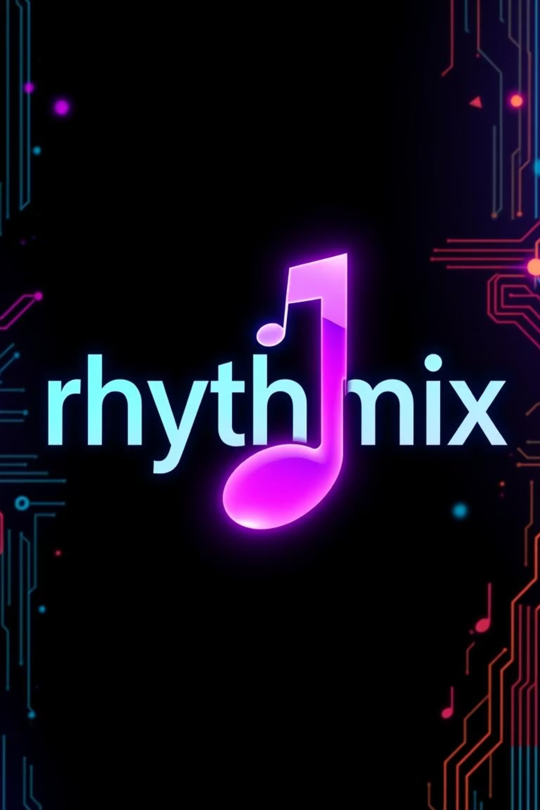
Rhythmix: Your Ultimate Music Streaming Experience
Rhythmix is a modern web application designed for music lovers seeking an intuitive and personalized streaming journey. It allows users to seamlessly browse, play, and manage their favorite tunes, all built with the cutting-edge MERN stack for superior performance and scalability.

Slide 3
Project Vision
Objective
Target Users
Core Value
To create a responsive, user-friendly music streaming platform, providing seamless access and management of music.
Primarily college students and casual listeners who desire easy access to a diverse music library.
Combining rich music discovery with smooth playback, robust management, a clean UI, and fast, reliable backend services.

Slide 4




Key Features of Rhythmix
Extensive Library
Seamless Playback
Browse a vast music collection with powerful search, filters, and curated playlists.
Enjoy uninterrupted audio streaming with intuitive play, pause, and skip controls.
Personalized Playlists
User Authentication
Manage your favorite tracks and create custom playlists with simple drag-and-drop functionality.
Secure login for a personalized experience, data persistence, and a responsive design across devices.

Slide 5

Technology Stack: MERN
Rhythmix is built on the robust MERN stack, offering a scalable and high-performance foundation for a seamless music streaming experience.
MongoDB: A flexible NoSQL database for efficient storage of user data and comprehensive music metadata.
Express.js: A powerful backend framework that powers our RESTful APIs, ensuring smooth data flow and responsiveness.
React.js: A dynamic, component-based frontend library enabling smooth user interactions and a modern interface.
Node.js: A scalable server environment capable of handling concurrent streaming requests and ensuring high availability.
Additional tools like JWT for secure authentication, Axios for API calls, and Cloudinary for robust media storage enhance functionality.

Slide 6
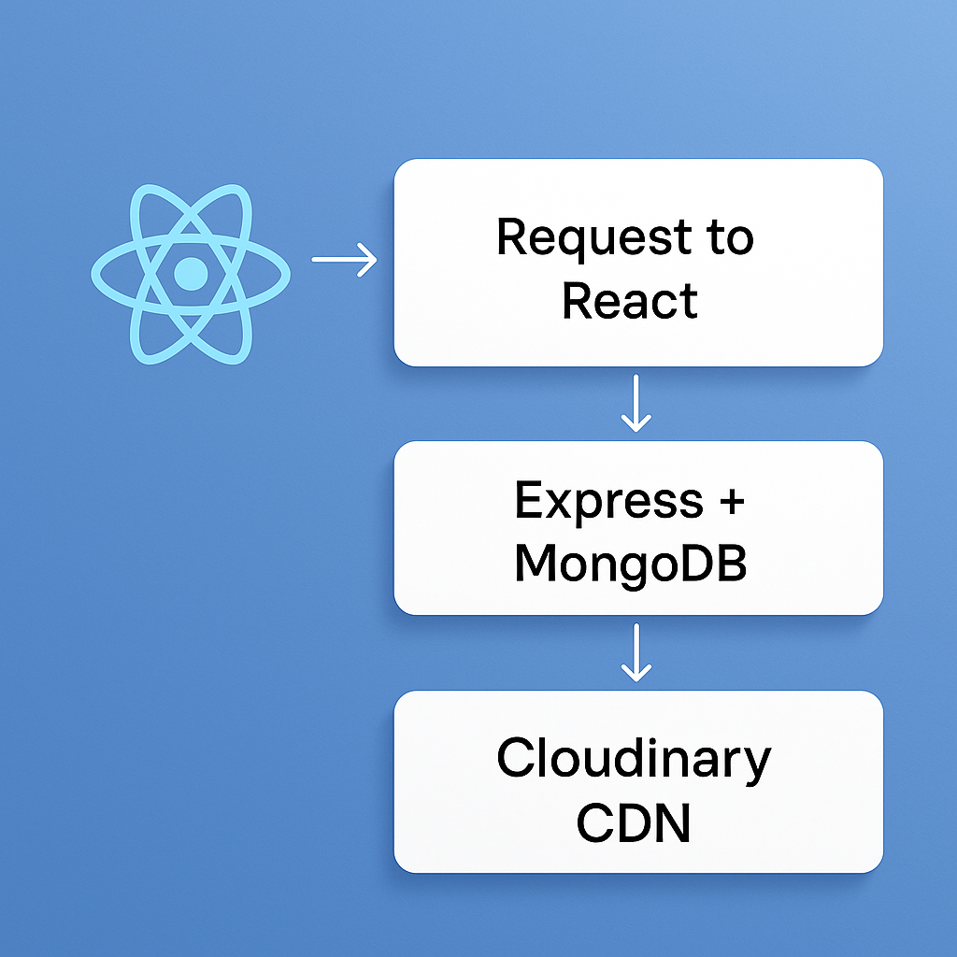
Architecture Diagram
The client-side React application communicates with the Express.js server, which manages user authentication, playlist operations, and music metadata. MongoDB stores user profiles and track information, while audio files are efficiently streamed from Cloudinary’s CDN for low latency and high availability.

Slide 7
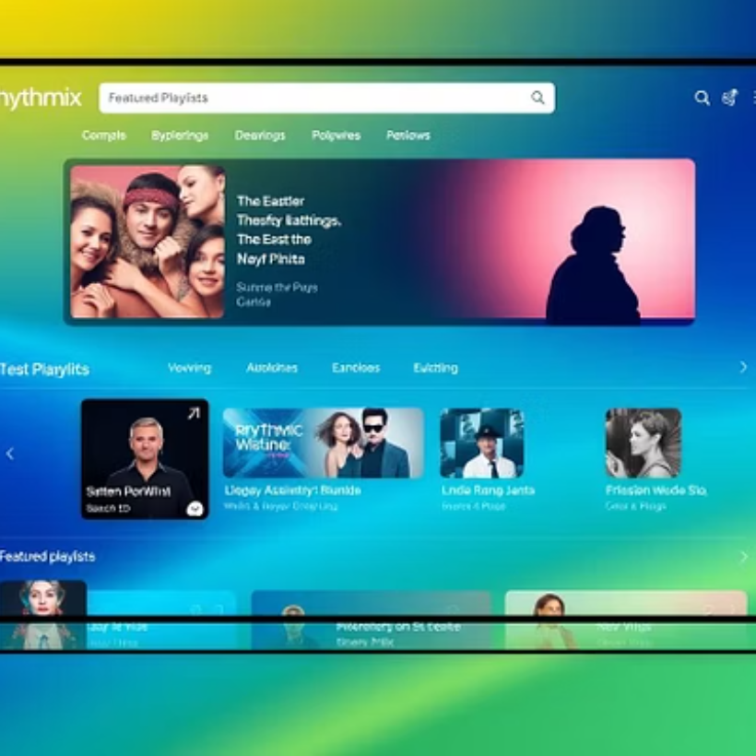
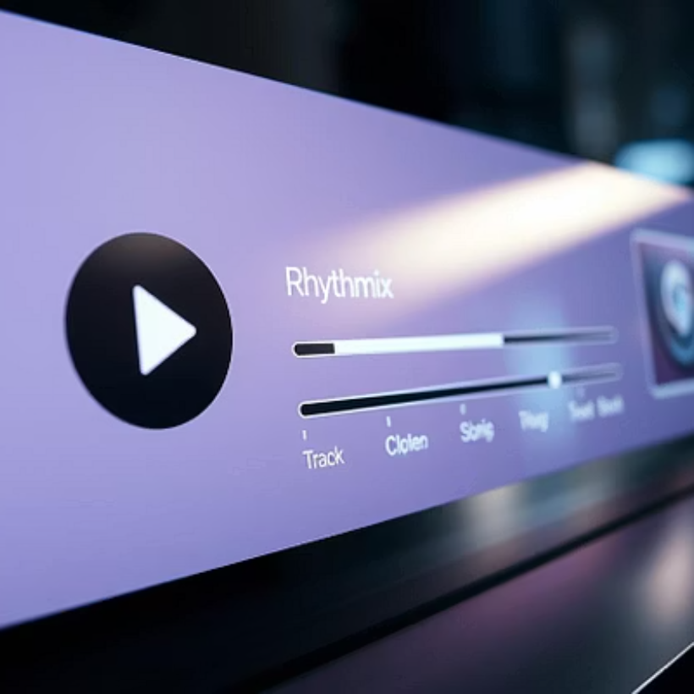

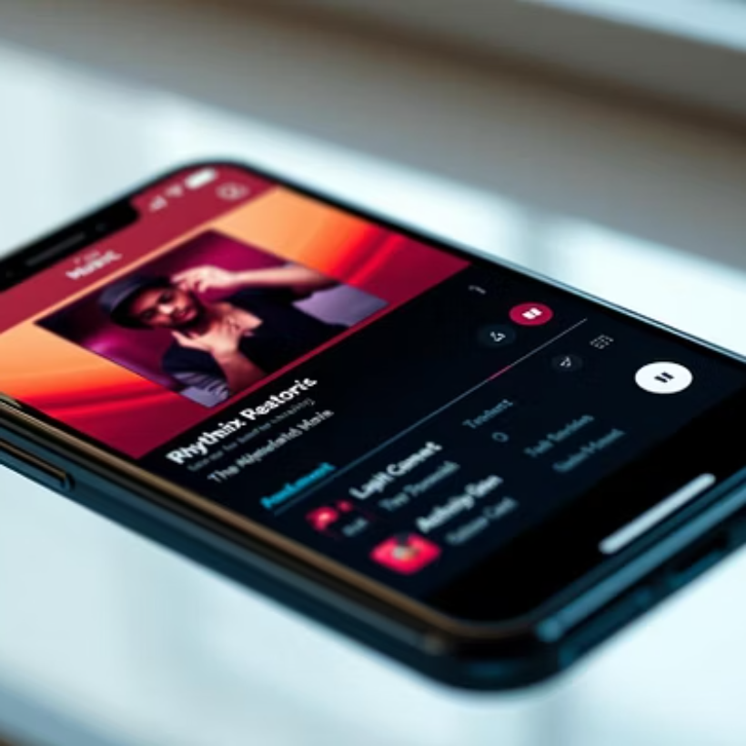
User Interface: A Visual Tour of Rhythmix
Our user interface is designed for simplicity and efficiency, ensuring a seamless experience across all devices. From the home screen to detailed playlist management and responsive mobile views, every element is crafted for intuitive interaction.

Slide 8
Backend Functionality
REST API Endpoints
Secure Authentication
Data Optimization
Optimized Streaming
Comprehensive REST API endpoints facilitate user login/signup and full CRUD (Create, Read, Update, Delete) operations for playlists and music management.
Robust JWT- Token based authentication and session management ensure user data security and a personalized experience.
Efficient querying and indexing in MongoDB enable rapid data retrieval, enhancing responsiveness.
Audio streaming is optimized with range requests and caching headers, minimizing buffering and ensuring smooth playback.
Cloudinary Integration
Server Reliability
Comprehensive error handling and
logging mechanisms guarantee
robust server performance and stability.
Upload audio files and cover images to Cloudinary
Generate and store URLs for fast streaming
Use Cloudinary CDN to ensure fast delivery

Slide 9





Challenges Faced During Development
Streaming Optimization
UI/UX Design
React State Management
Ensuring smooth, buffer-free audio streaming under varying network conditions and user loads was a key challenge.
Balancing feature richness with an intuitive, simple user interface required careful planning and iteration.
Efficiently managing complex state in React to support real-time playback updates and user interactions was critical.
Secure Authentication
Cloud Integration
Implementing robust and secure authentication without compromising the user experience posed a significant hurdle.
Seamlessly integrating Cloudinary for scalable media delivery while maintaining performance required detailed configuration.

Slide 10
Future Scope: Enhancing Rhythmix
AI Recommendations
Integrate AI-driven algorithms for personalized music recommendations, enhancing user discovery and engagement.
Social Features
Add social elements such as playlist sharing, following friends, and collaborative playlists to build a community.
Offline Playback
Implement local caching to support offline music playback, ensuring uninterrupted listening.
Mobile Expansion
Develop native mobile applications using React Native for a more optimized and responsive user experience.
Analytics Dashboard
Incorporate an analytics dashboard to provide insights into user engagement and content performance.

Slide 11

Conclusion: The Rhythm Continues
Rhythmix stands as a robust and modern music streaming application, seamlessly blending powerful MERN stack technology with a sleek design and rich features. It’s tailored for today’s users, offering an intuitive and immersive experience. With exciting future enhancements planned, Rhythmix is poised for significant growth and continued innovation.
Thank you for your time

Slide 12


